Slide 1
CPARS OVERVIEW
Presented by: Pamela Monroe
Date: August 11, 2021

Slide 2
Agenda
What is CPARS?
Roles
Responsibilities
When and Why CPARS?
How to evaluate?
CPARS Metrics
Questions

Slide 3
What is CPARS?
Contractor Performance Assessment Reporting System (CPARS)
  CPARS is a web-enabled application that collects and manages the library of automated Contractor Performance Assessment Reports (CPAR). A CPAR assesses a contractor's performance and provides a record, both positive and negative, on a given contractor during a specific period of time
  www.cpars.gov
CPARs Capabilities
  Single Sign On (PKI or email/password)
  Writing and Reviewing Evaluations
  Creating Integrity Records
  Viewing Performance and Integrity Records
  Managing and Reviewing Accounts and Records
  Reviewing and Commenting on Evaluations
  Managing Users (Focal Point)

Slide 4

CPARS ROLES
CPARS Roles
  Assessing Official Representative (COR)
  Assessing Official (Contracting Officer)
  Reviewing Official
  Contractor Representative

Slide 5
  Assessing Official Representative (COR) - Responsible for Drafting Report and submitting for KO review
  Assessing Official (KO) – Responsible for Rating Report and submitting to Contractor Representative
  Reviewing Official – Responsible for reviewing ratings and finalizing report
  Contractor Representative – Responsible for reviewing report and concurring or non-concurring with rating on behalf of contractor
  Focal Point – Responsible for managing CPARs roles, resolving issues, and reporting metrics
Responsibilities

Slide 6
  Evaluation Status
  Registered – The contract is registered, no Evaluations have been initiated
  Initiated – Waiting for Assessing Official Rep to send to Assessing Official
  Drafted – Waiting for Assessing Official review and signature (validation)
  Rated – Signed by Assessing Official, waiting for Contractor Rep comments
  Reviewed – Signed by Contractor Rep or Contractor Rep comment period expired; waiting for Assessing Official to finalize
  Finalized – Ratings finalized; waiting for Reviewing Official comments
  Completed – The Evaluation has been completed and no further action is required

Slide 7
When and Why CPARS?
WHEN? CPARS evaluations are due four (4) months (120 days) after completion of annual contract performance
  FPDS-NG will push the contract to CPARs after contract award (typically occurs within 30 days)
  1 month before the PoP ends, CPARS will notify the COR to initiate evaluations
  Once the KO signs the CPARS evaluations and submits to Contractor Rep, the Contractor rep has 60 days to complete review (therefore COR and KO have 1st 60 days to complete evaluation)
  Contract Administration really takes place during the year of performance so CORs and KOs should maintain notes throughout the year
WHY? CPARS is required by FAR PART 42.15 – Contractor Performance Information
  When CPARs is completed, contractor performance information is available to the public (for 3 years) to use for future awards which results in government selecting vendors that perform well (former PPIR system is embedded in CPARs)
  If a vendor performed poorly, it needs to be documented in CPARS to influence future contract award decisions
  When completed timely, it shows proper contract administration and oversight
  Incomplete CPARS are counted against the agency and will not support proper contract administration was performed

Slide 8
How to Evaluate
Evaluation Areas:
  Quality
  Schedule
  Cost Control
  Management
  Small Business Subcontracting
  Regulatory Compliance
  Other areas identified by KO
Ratings
  Exceptional
  Very Good
  Satisfactory
  Marginal
  Unsatisfactory

Slide 9
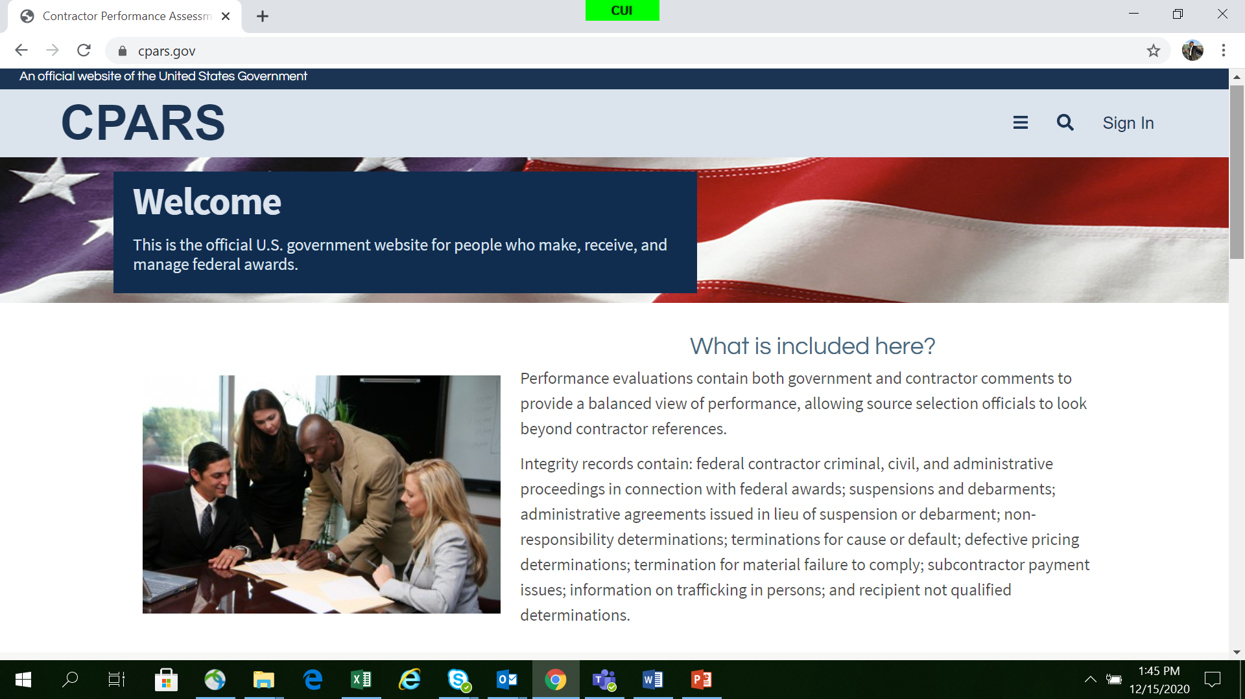
CPARS.gov
Notes:
Note: Might mention the future use of the Mentor-Protégé’ Program when reinstated.

Slide 10
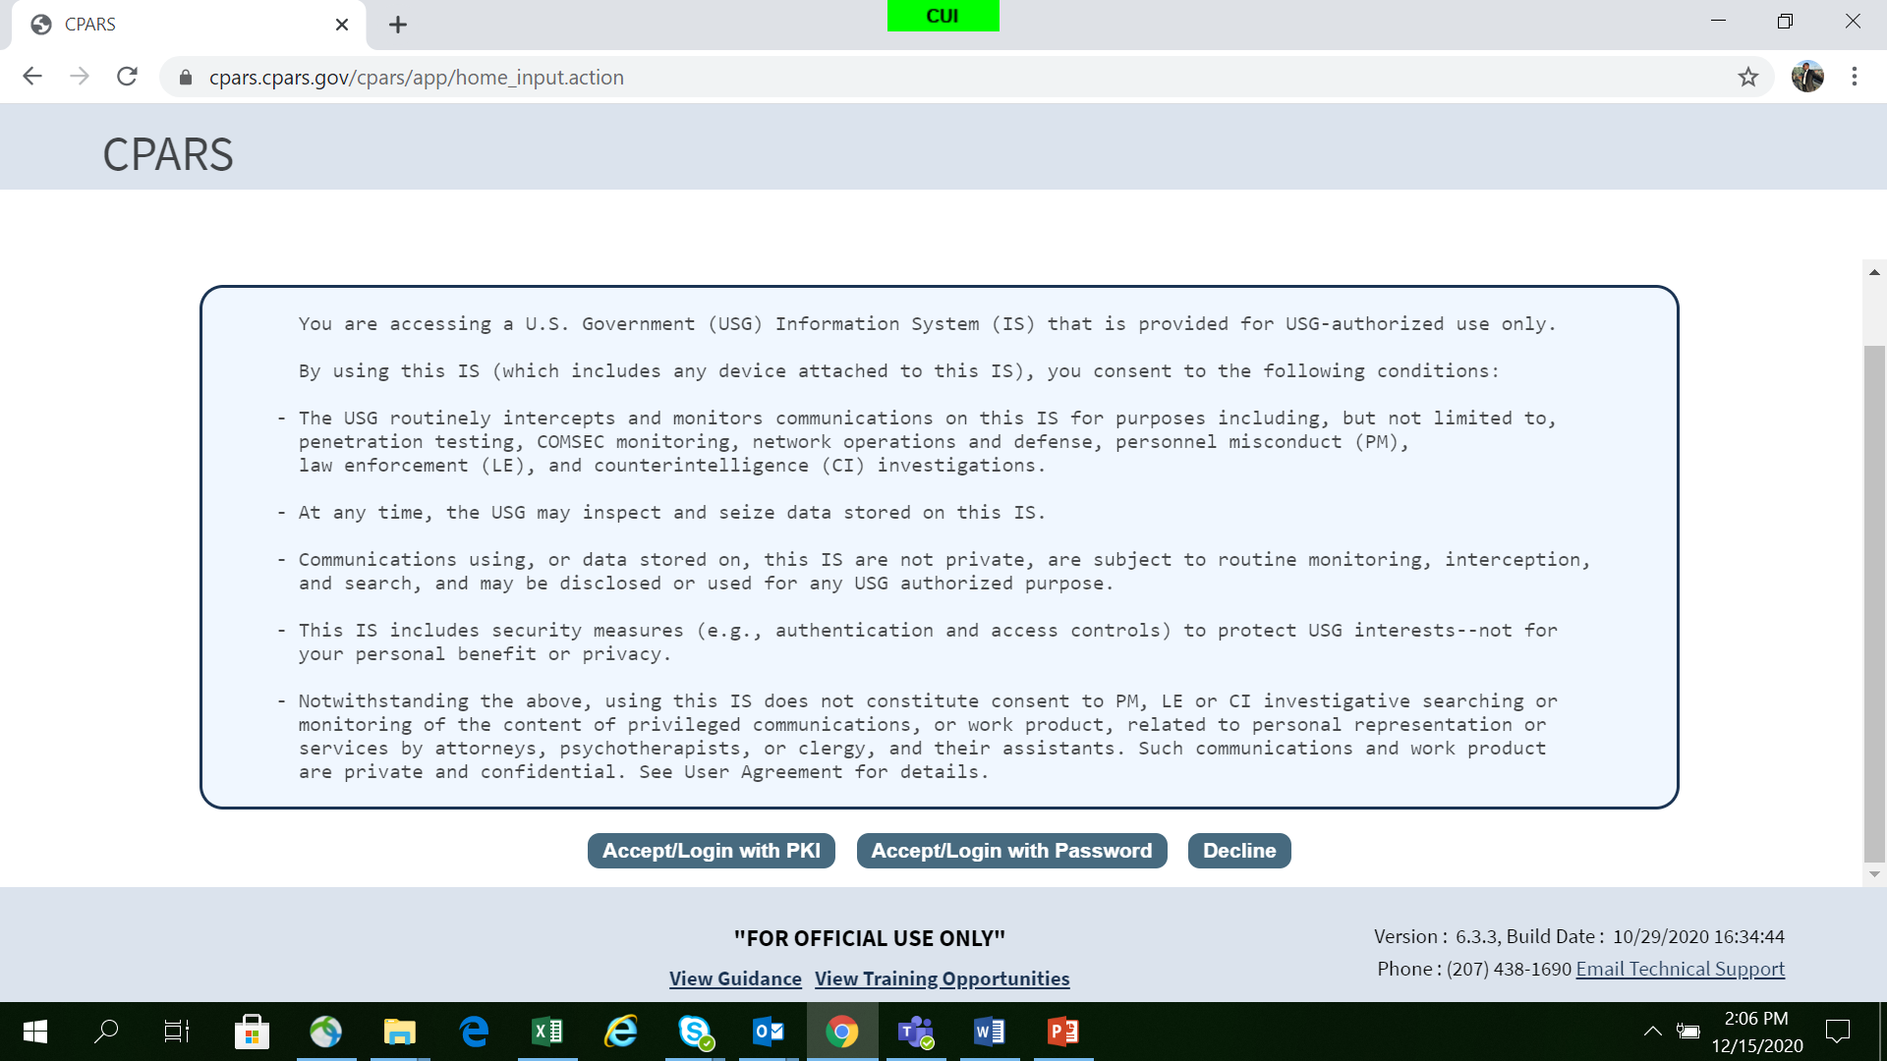
Login Screen

Slide 11
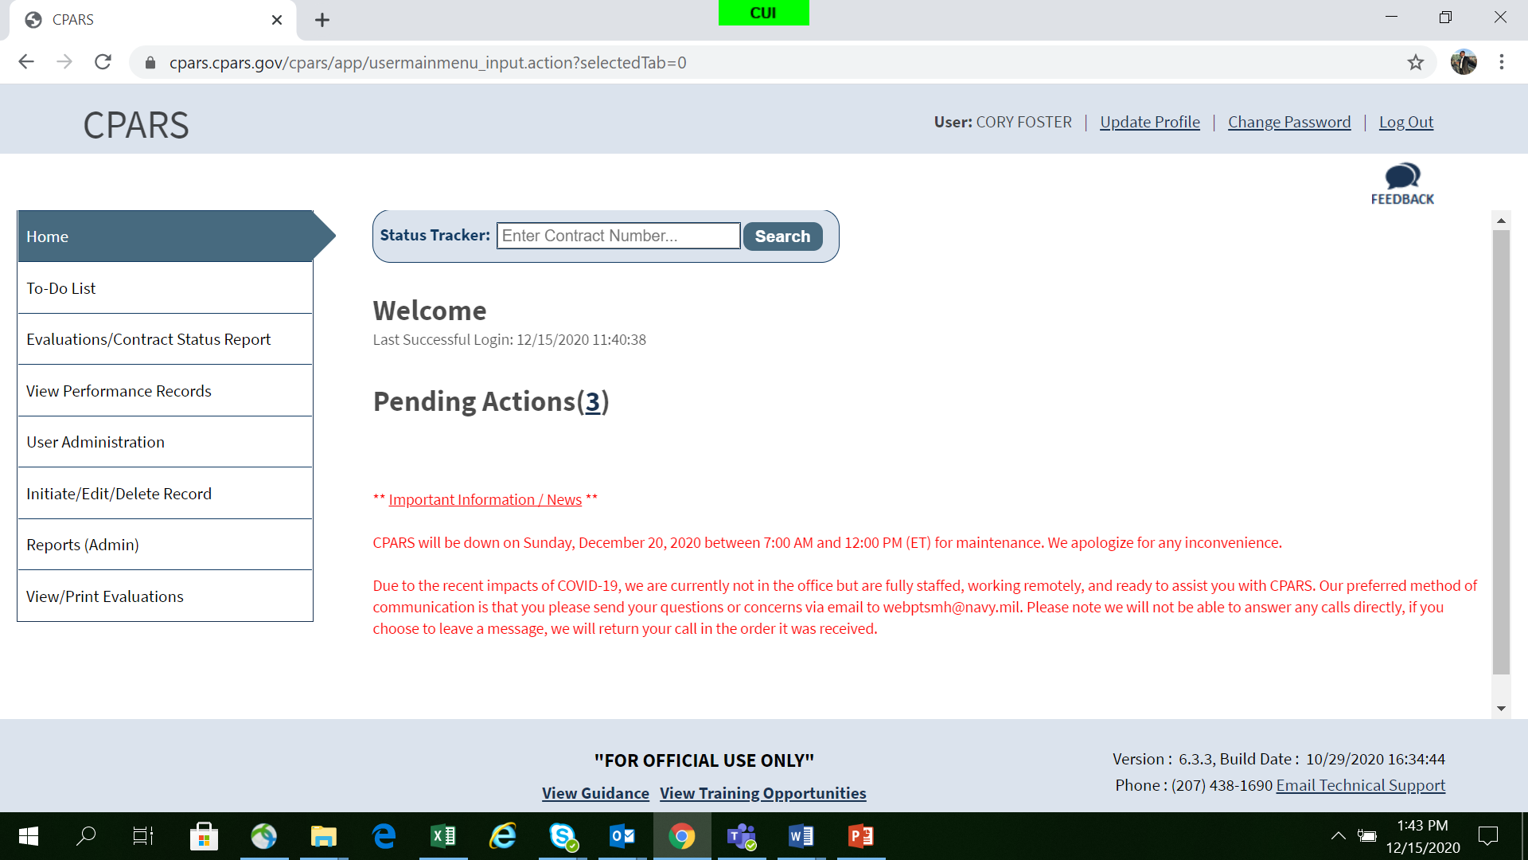
CPARS Home Screen

Slide 12
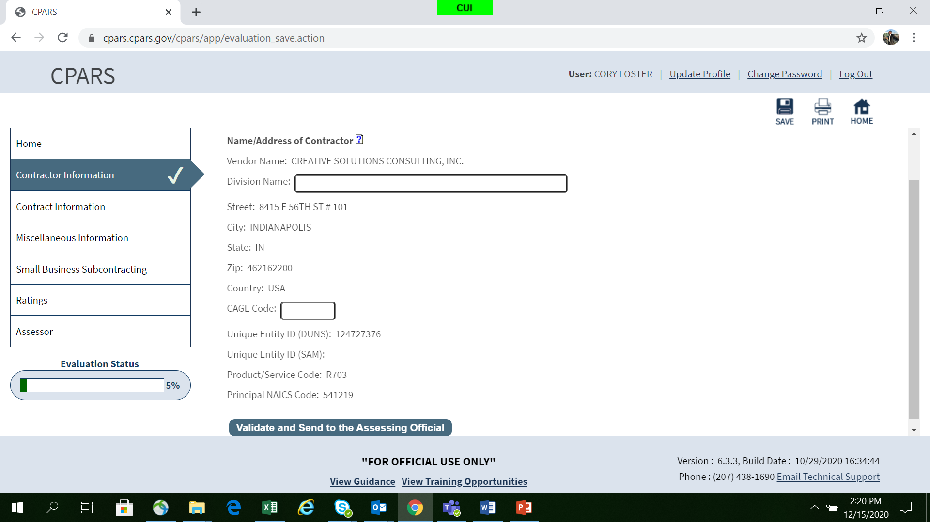
Contract info tab
.

Slide 13
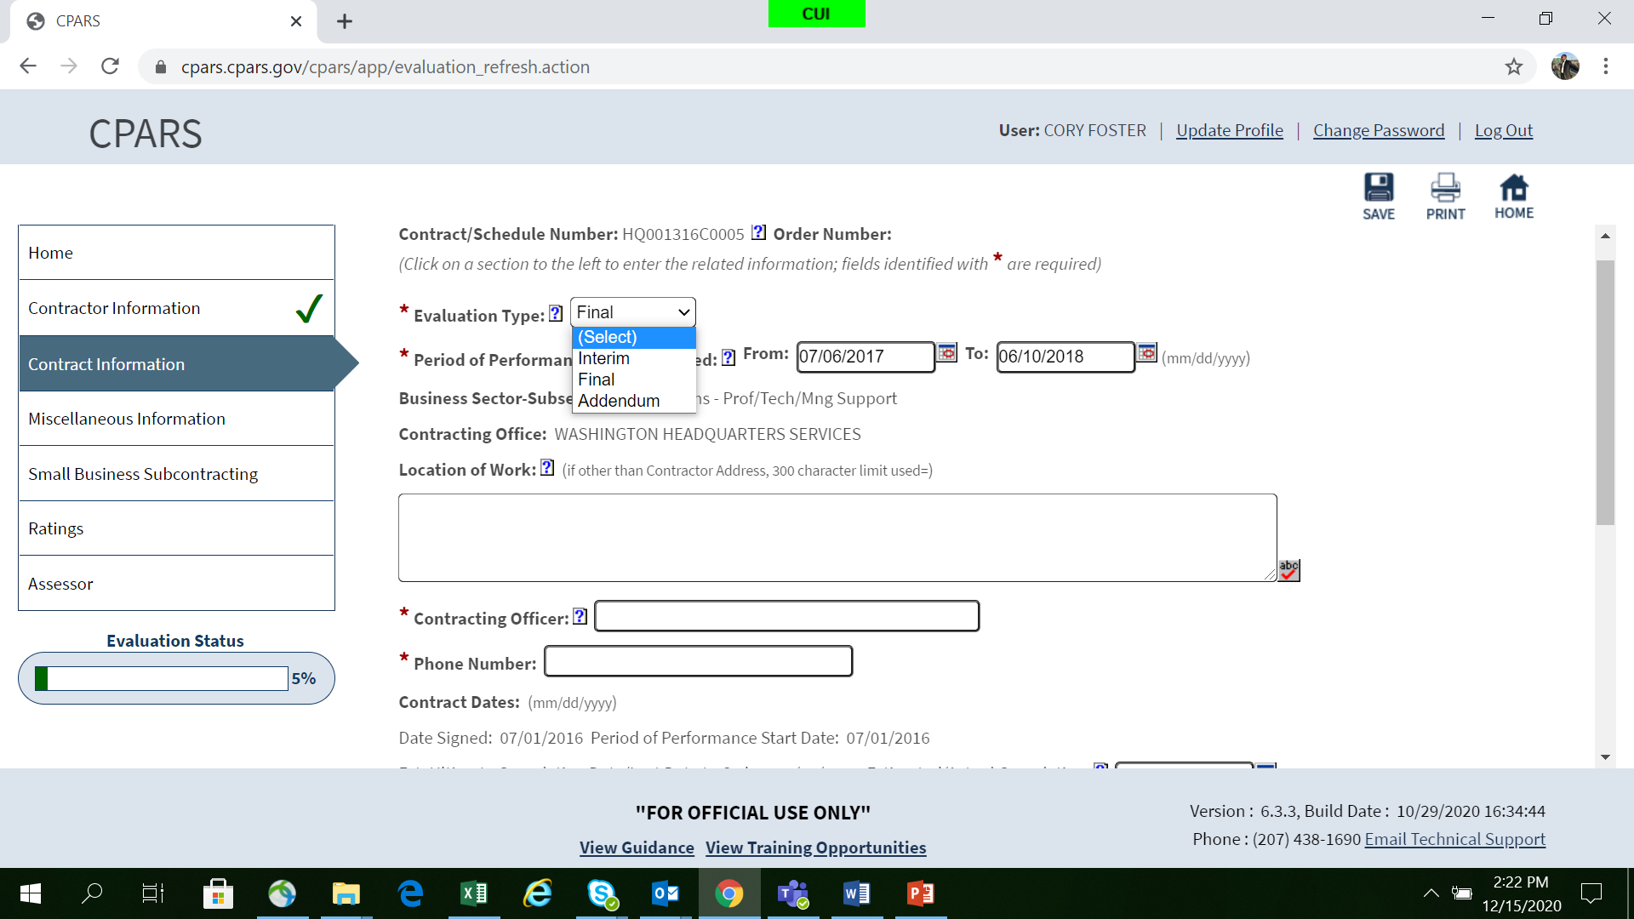
Contract info tab
.

Slide 14
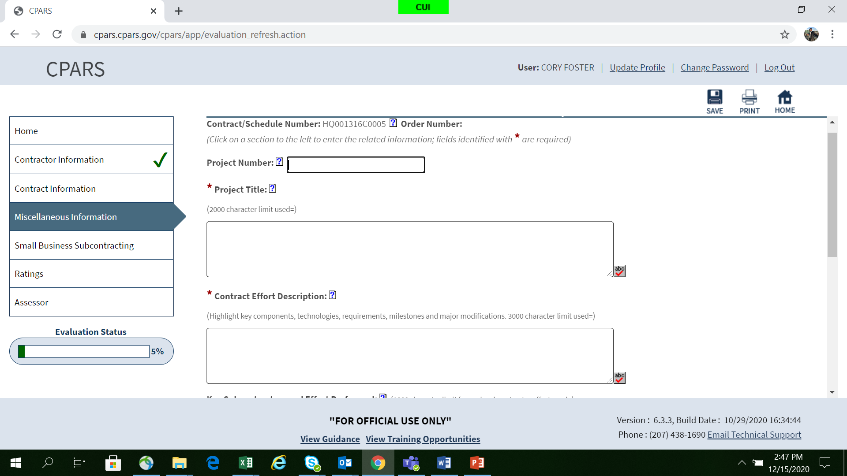
MISC INFO TAB

Slide 15
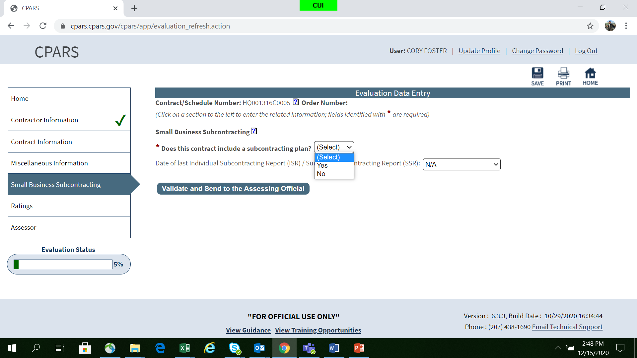
Small business sub tab

Slide 16
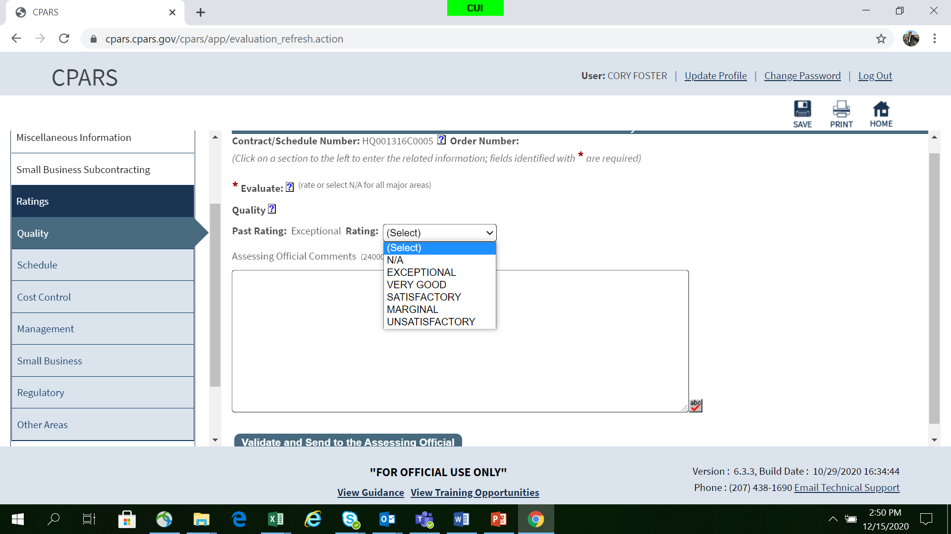
Ratings

Slide 17
Evaluation Ratings Definitions
Rating | Definition | Note
Exceptional | Performance meets contractual requirements and exceeds many to the Government’s benefit. The contractual performance of the element or sub-element being evaluated was accomplished with few minor problems for which corrective actions taken by the contractor were highly effective. | To justify an Exceptional rating, identify multiple significant events and state how they were of benefit to the Government. A singular benefit, however, could be of such magnitude that it alone constitutes an Exceptional rating. Also, there should have been NO significant weaknesses identified.
Very Good | Performance meets contractual requirements and exceeds some to the Government’s benefit. The contractual performance of the element or sub-element being evaluated was accomplished with some minor problems for which corrective actions taken by the contractor was effective. | To justify a Very Good rating, identify a significant event and state how it was a benefit to the Government. There should have been no significant weaknesses identified.
Satisfactory | Performance meets contractual requirements. The contractual performance of the element or sub-element contains some minor problems for which corrective actions taken by the contractor appear or were satisfactory. | To justify a Satisfactory rating, there should have been only minor problems, or major problems the contractor recovered from without impact to the contract/order. There should have been NO significant weaknesses identified. A fundamental principle of assigning ratings is that contractors will not be evaluated with a rating lower than Satisfactory solely for not performing beyond the requirements of the contract/order.
Marginal | Performance does not meet some contractual requirements. The contractual performance of the element or sub-element being evaluated reflects a serious problem for which the contractor has not yet identified corrective actions. The contractor’s proposed actions appear only marginally effective or were not fully implemented. | To justify Marginal performance, identify a significant event in each category that the contractor had trouble overcoming and state how it impacted the Government. A Marginal rating should be supported by referencing the management tool that notified the contractor of the contractual deficiency (e.g., management, quality, safety, or environmental deficiency report or letter).
Unsatisfactory | Performance does not meet most contractual requirements and recovery is not likely in a timely manner. The contractual performance of the element or sub-element contains a serious problem(s) for which the contractor’s corrective actions appear or were ineffective. | To justify an Unsatisfactory rating, identify multiple significant events in each category that the contractor had trouble overcoming and state how it impacted the Government. A singular problem, however, could be of such serious magnitude that it alone constitutes an unsatisfactory rating. An Unsatisfactory rating should be supported by referencing the management tools used to notify the contractor of the contractual deficiencies (e.g., management, quality, safety, or environmental deficiency reports, or letters).

Slide 18
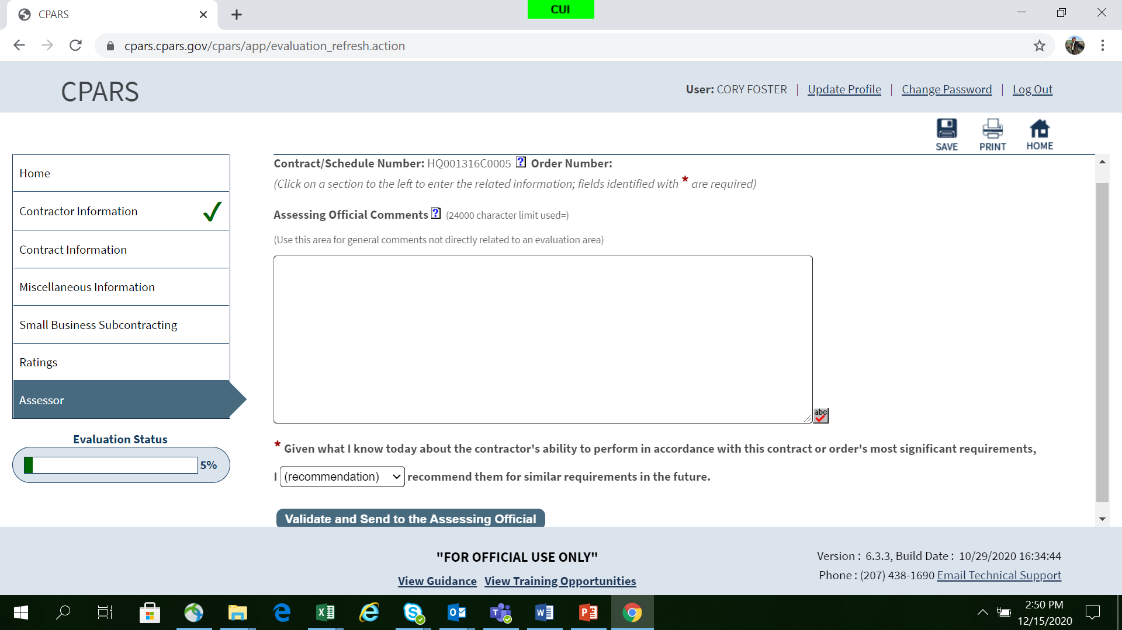
Assessor tab

Slide 19
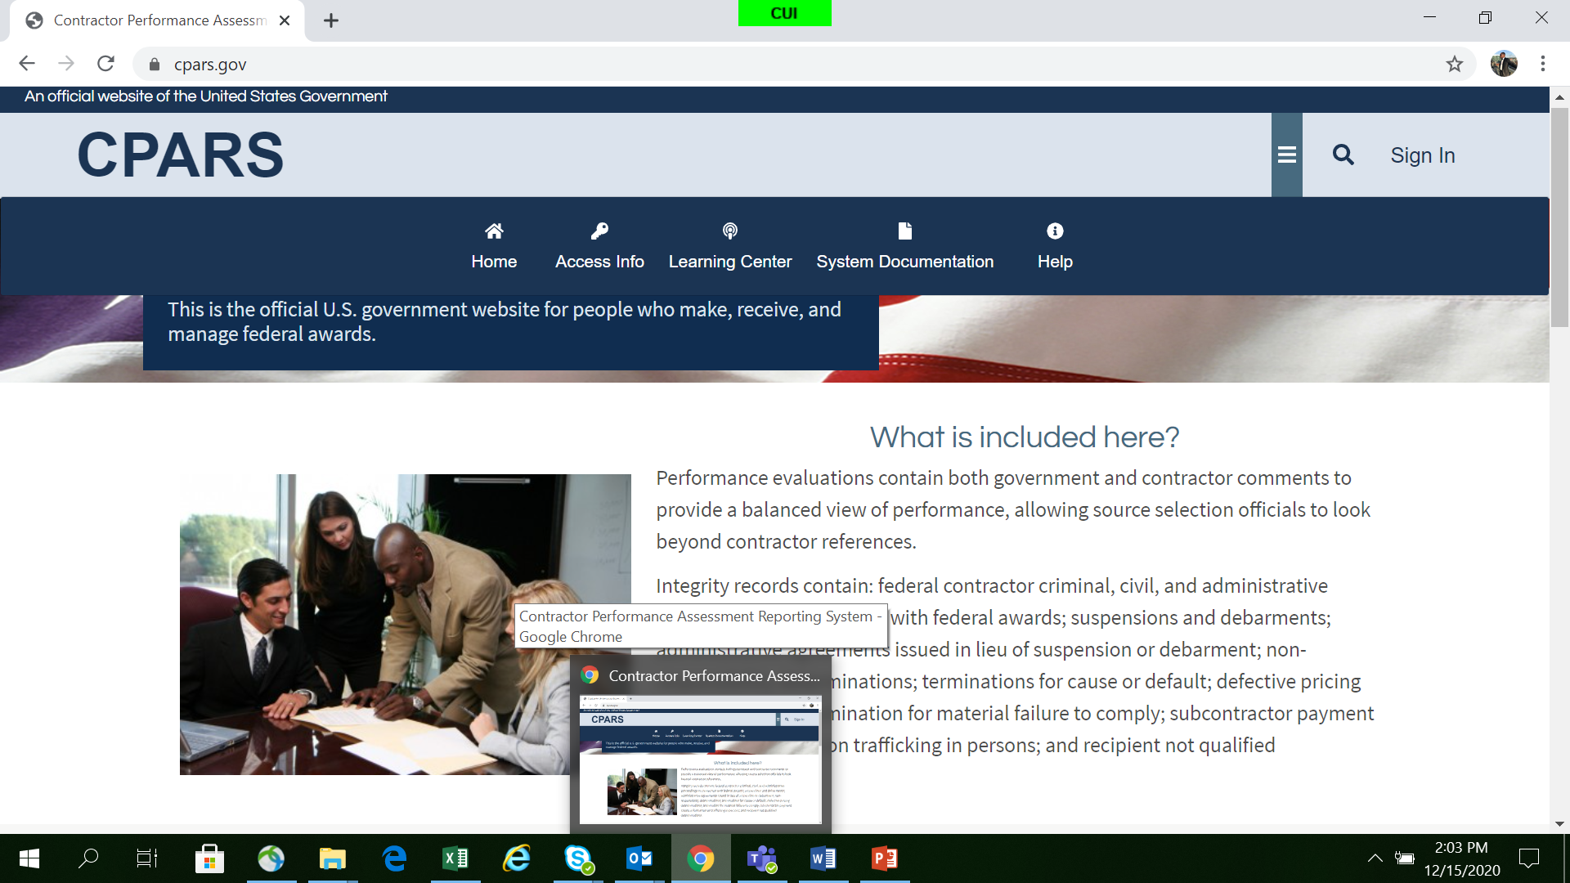
Horizontal tool bar

Slide 20
Sample CPAR Narrative
Element Assessed: Quality
Sufficient? Yes or No
Quality - Rating: Exceptional
The contractor is exceptional. They continuously provide high quality training and services.
Notes:
(missing detail)

Slide 21

Sample CPAR Narrative
NOT Sufficient
Quality - Rating: Exceptional
The contractor is exceptional. They continuously provide high quality training and services.
Missing:
  Detail to Support Rating
  Detail to Tell Entire Story
  Supporting Documentation / Metrics

Slide 22

Sample CPAR Narrative
Sufficient
Quality - Rating: Exceptional
Contractor has provided exceptional quality to our 40 worldwide locations during this reporting period. For example, ST requirements were changed and Contractor adjusted to providing 15 training sessions per month versus 10 without additional cost through use of an “express set up” module which requires less instructor preparation time. This allowed users to be trained 3 months more quickly than required. The contractor also aggressively represented the government’s interest in dealing with their vendor to correct a system software malfunction. They worked with the vendor to revise the terms and conditions of the warranty clause to correct errors with no cost to the government. They also implemented a new risk management system which reduced potential risk actions by 50%. This also saved the government considerable stress and ensured a constant throughput of aircrew members trained.
Note: Actual narratives should go into even greater detail!

Slide 23
Sample CPAR Narrative
Element Assessed: Schedule
Sufficient? Yes or No
Schedule – Rating: Very Good
In our opinion, the contractor has done really well in terms of schedule. The Training Manager, Jack Jones is pleasant and easy to work with. He adapts to our schedule changes amazingly and never complains. He also went above and beyond and fixed our printer and fax without charging the government and he continued to meet all the contract objectives in the interim. Great job!

Slide 24
Sample CPAR Narrative
NOT Sufficient
Schedule – Rating: Very Good
In our opinion, the contractor has done really well in terms of schedule. The Training Manager, Jack Jones is pleasant and easy to work with. He adapts to our schedule changes amazingly and never complains. He also went above and beyond and fixed our printer and fax without charging the government and he continued to meet all the contract objectives in the interim. Great job!
Missing:
  Detail to Support Rating
  Supporting Documentation / Metrics
  Additional Issues:
  Using Individual’s Name
  Outside Contract Scope
  Subjective Phrases

Slide 25
Sample Narrative
Statements to Avoid
  Outside Contract Scope
  In Our Opinion
  It Appeared
  We Believe
  We Hope
  We Were Not Happy
  We Did Not Like
  We Think
Notes:
**NOTES**
Outside Contract Scope = Contractor could submit claim saying we owe them more $

Slide 26
Sample CPAR Narrative
Sufficient
Schedule – Rating: Very Good
Contractor successfully executed the delivery and training requirements for this period ahead of schedule. For example, there were 20 training site visits scheduled for this period however, the contractor conducted 31 visits in the same period of time. The contractor also met 100% of the 13 contract data requirements in a 45 day timeframe versus the 60 days allotted. This resulted in data requirements 14-20 being completed earlier than anticipated. This was done with minimal supervision by the program office hence allowing more time for additional projects. A 20 site preventative maintenance visit ran behind schedule for the first 8 months of the reporting period due to equipment failures, but Contractor management was able to bring the visit back on schedule due to implementation of an aggressive quality management system and spares availability policy.
Notes:
**NOTES**
Write narratives first before rating
Rating changed when they added more detail

Slide 27
Sample CPAR Narrative
Element Assessed: Management Of Key Personnel
Management of Key Personnel - Rating: Marginal
The Contractor has exhibited marginal management of key personnel. While instructor resumes are due to the Contracting Officer at least 30 days prior to placing an instructor in class, 30% of resumes have been provided closer than this timeframe, some within a 7 day window. Two of these last minute resumes have been rejected with no replacement instructor being available, forcing a class cancellation. In addition, the Contractor has been unable to attract and retain qualified instructor personnel during this reporting period. The Instructor and Senior Instructor labor categories have experienced 40% and 35% turnover rates respectively. Contractor management is addressing the situation by aggressively recruiting at industry job fairs and in trade publications, but no improvement has been noted to date.
Sufficient? Yes or No

Slide 28
Sample CPAR Narrative
Sufficient
Management of Key Personnel - Rating: Marginal
The Contractor has exhibited marginal management of key personnel. While instructor resumes are due to the Contracting Officer at least 30 days prior to placing an instructor in class, 30% of resumes have been provided closer than this timeframe, some within a 7 day window. 2 of these last minute resumes have been rejected with no replacement instructor being available, forcing a class cancellation. In addition, the Contractor has been unable to attract and retain qualified instructor personnel during this reporting period. The Instructor and Senior Instructor labor categories have experienced 40% and 35% turnover rates respectively. Contractor management is addressing the situation by aggressively recruiting at industry job fairs and in trade publications, but no improvement has been noted to date.
Contains:
  Detail to Support Rating
  Documentation/Metrics
  Corrective Actions
  Objective Language
Notes:
?’s

Slide 29
CPAR Disagreements
Potential Areas for Disagreement
- Rating doesn’t reflect actual performance
Assessing Official (AO) narrative contains inaccurate, unsupported, or unclear statements
AO narrative includes areas not covered by the stated evaluation criteria

Slide 30
Handling a CPARS Disagreement
The contractor has 14 days to respond to the evaluation rating and narrative in CPARS before the CPAR appears in PPIRS
  Then 60 days to respond before it is finalized.
The Contractor Rep (CR) submits comments addressing the AO’s ratings and narrative
  This is when the contractor can “non-concur” with the CPAR
The Reviewing Official (RO) reviews the issue
  The RO may sustain the ratings or adjust the ratings and narrative
  The RO must acknowledge consideration of any significant discrepancies
If the contractor disagrees after the RO signs the CPAR, the contractor may request a Contracting Officer Final Decision

Slide 31
Government Best Practices
Know the CPAR rules in the FAR and CPARS Guide. See FAR Subpart 42.15; See also Guidance for the Contractor Performance Assessment Reporting System (July 2018)
Document and communicate performance issues – avoid surprise
Allow sufficient time for corrective action
Understand the issue and its relationship to the contract requirements
Use facts to back up assertions – avoid emotional responses
Consider providing a draft CPAR
Avoid arguing over issues within the CPAR system

Slide 32
Contractor Best Practices
Strive for exceptional performance…
  Document successful performance actions such as early deliveries and performance that exceeds requirements
  Respond to all government communications
Know the CPAR rules, timelines and govt officials (AO and RO)
Address issues early – document responses and corrective actions – avoid surprises
  Communicate concerns to the COR and/or contracting officer as they arise
Request a draft CPAR when there may be issues
  Attempt to solve problems prior to the formal CPAR process
Request additional time for corrective action, if needed
Challenge ratings and narratives using FAR and CPARS guidelines

Slide 33
Summary
The government and the contractor should work together to achieve successful outcomes
The contractor must perform exceptionally to justify exceptional ratings
Use the CPARS process to ensure ratings and narratives are accurate and fair
When there is disagreement over CPARS ratings and narratives, strive to correct the record
When all else fails, request a Contracting Officer’s Final Decision to preserve rights

Slide 34
Challenging Final CPAR Decisions
A contractor cannot challenge the substance of a CPAR through a bid protest.
--Itility, LLC v. United States, 124 Fed. Cl. 452 (2016)
--ProActive Technologies, Inc.; CymSTAR Services, LLC, B-412957.5, Aug. 23, 2016, 2016 CPD ¶ 244 (observing that to the extent the protester challenged the contents of a CPAR, the protester “raise[d] a matter of contract administration, which [GAO does] not review”).

Slide 35
The Court of Federal Claims and Boards of Contract Appeals can consider challenges to CPARS under the Contract Disputes Act
Todd Construction, L.P. v. U.S., 656 F.3d 1306 (Fed. Cir. 2011)
Federal Contracting Inc. v. U.S., 128 Fed. Cl. 788 (2016)
BLR Group of America, Inc. v. U.S., 84 Fed. Cl. 634 (2008)
Colonna’s Shipyard, Inc., ASBCA No. 59987, Oct. 6, 2016, 16-1 BCA ¶ 36518

Slide 36
Injunctive relief is unavailable
Davis Group, Inc. v. United States, 2012 WL 2686053 (Fed. Cl. 2012)
YRT Enterprises, LLC DBA Tompkins Investigation Services, CBCA No. 5701, July 26, 2017, 17-1 BCA ¶ 36809
Microtechnologies, LLC, ASBCA No. 59911, Sept. 29, 2015, 15-1 BCA ¶ 36125
CompuCraft, Inc., CBCA No. 5516, Mar. 1, 2017, 17-1 BCA ¶ 36662

Slide 37
Could try to seek monetary damages or declaratory relief
Todd Construction, L.P. v. U.S., 656 F.3d 1306 (Fed. Cir. 2011)
Government Services Corp., ASBCA No. 60367, June 20, 2016, 16-1 BCA ¶ 36411

Slide 38


Government Contracting & Program Officials
Government Source Selection Officials
CPARS
Contractor Representative
Contractor Senior Management

Slide 39
QUESTIONS
Pamela Monroe
Subcontracting Program Manager
pamela.l.monroe8.civ@mail.mil
703-695-3220

